Slide 1
Public Group Meeting (7/9/24)
Somdeepa Das

Slide 2
Overview for last week
Exploratory analysis with elections data
Calculating turnout of local level elections from county-level historical turnout figures
Relationship between turnout and voting patterns
Religion and voting patterns
Data from https://www.usreligioncensus.org/
IRB application materials (Texas natality and mortality data)

Slide 3
Turnout in Local options Elections
Calculation of election-level turnout
Elections occurs in cities/precincts/counties
Historical turnout data exists for counties (1988 onwards)
To find out the turnout in a city in a given year, I multiplied the county turnout with the county population weight of the city.
This is the imputed turnout. It approximates the proportion of voters in a city who voted in the most recent General election (presidential or gubernatorial).
I also calculated the turnout using the actual votes cast in a local election (for votes + against votes). This is the actual turnout.
Precincts are ignored for now.

Slide 4
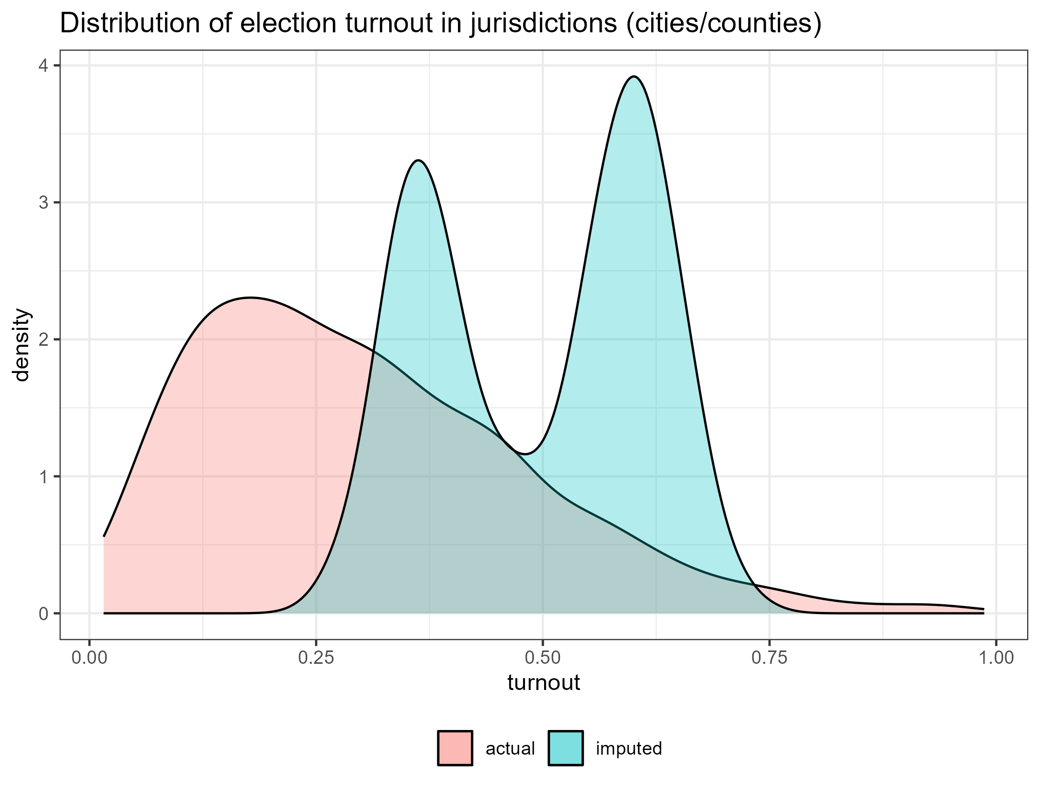
Actual and Imputed Turnouts

Slide 5
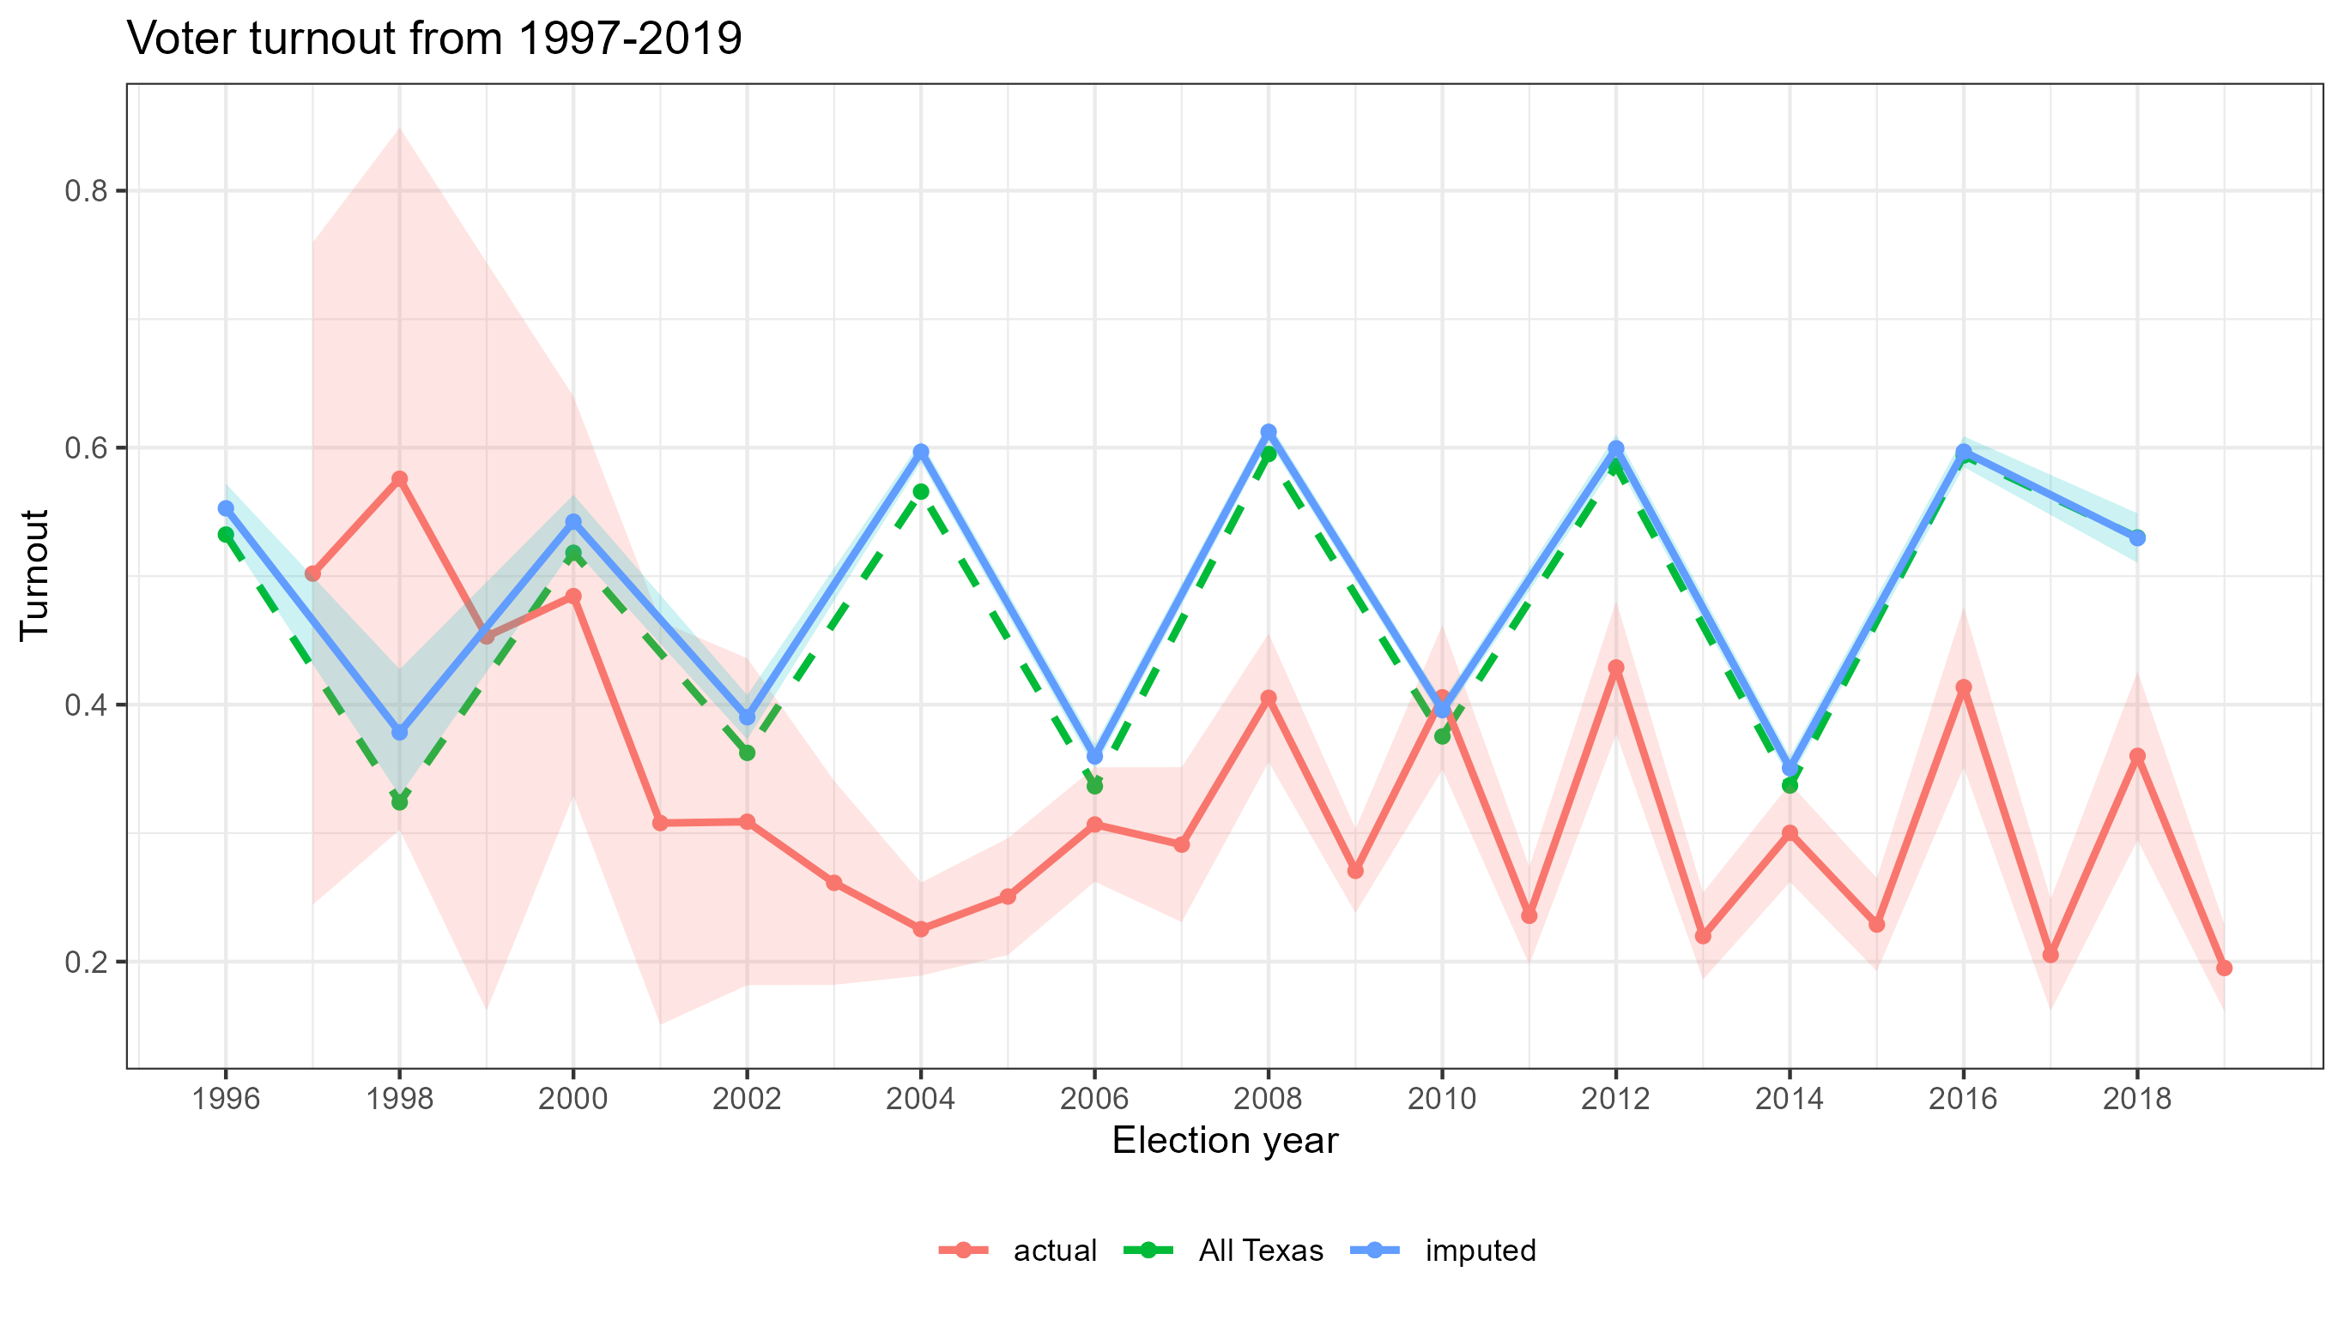
Turnout over time

Slide 6
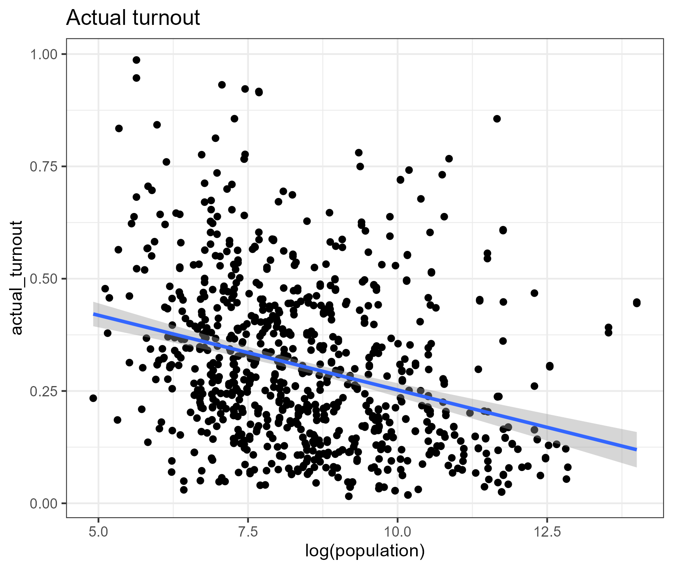
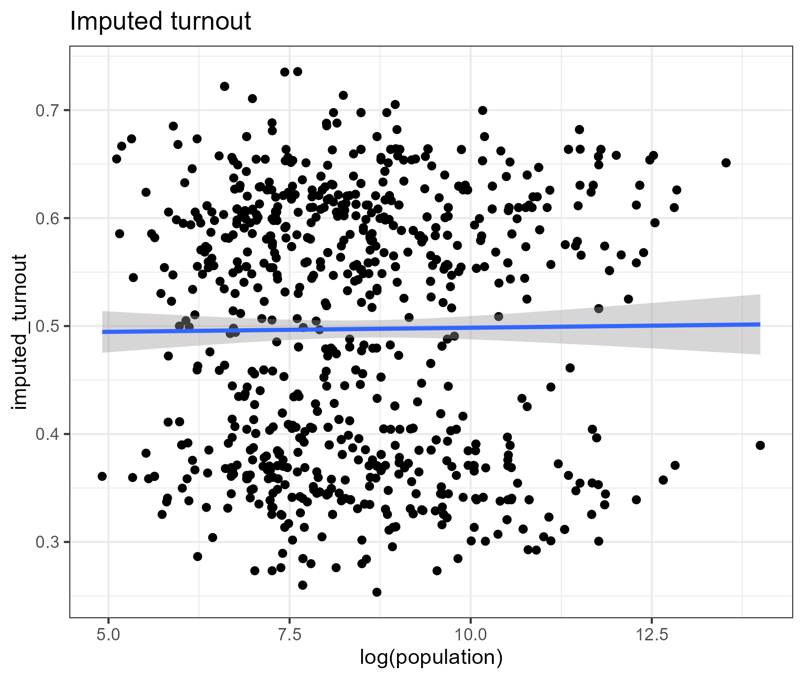
Turnout and population

Slide 7
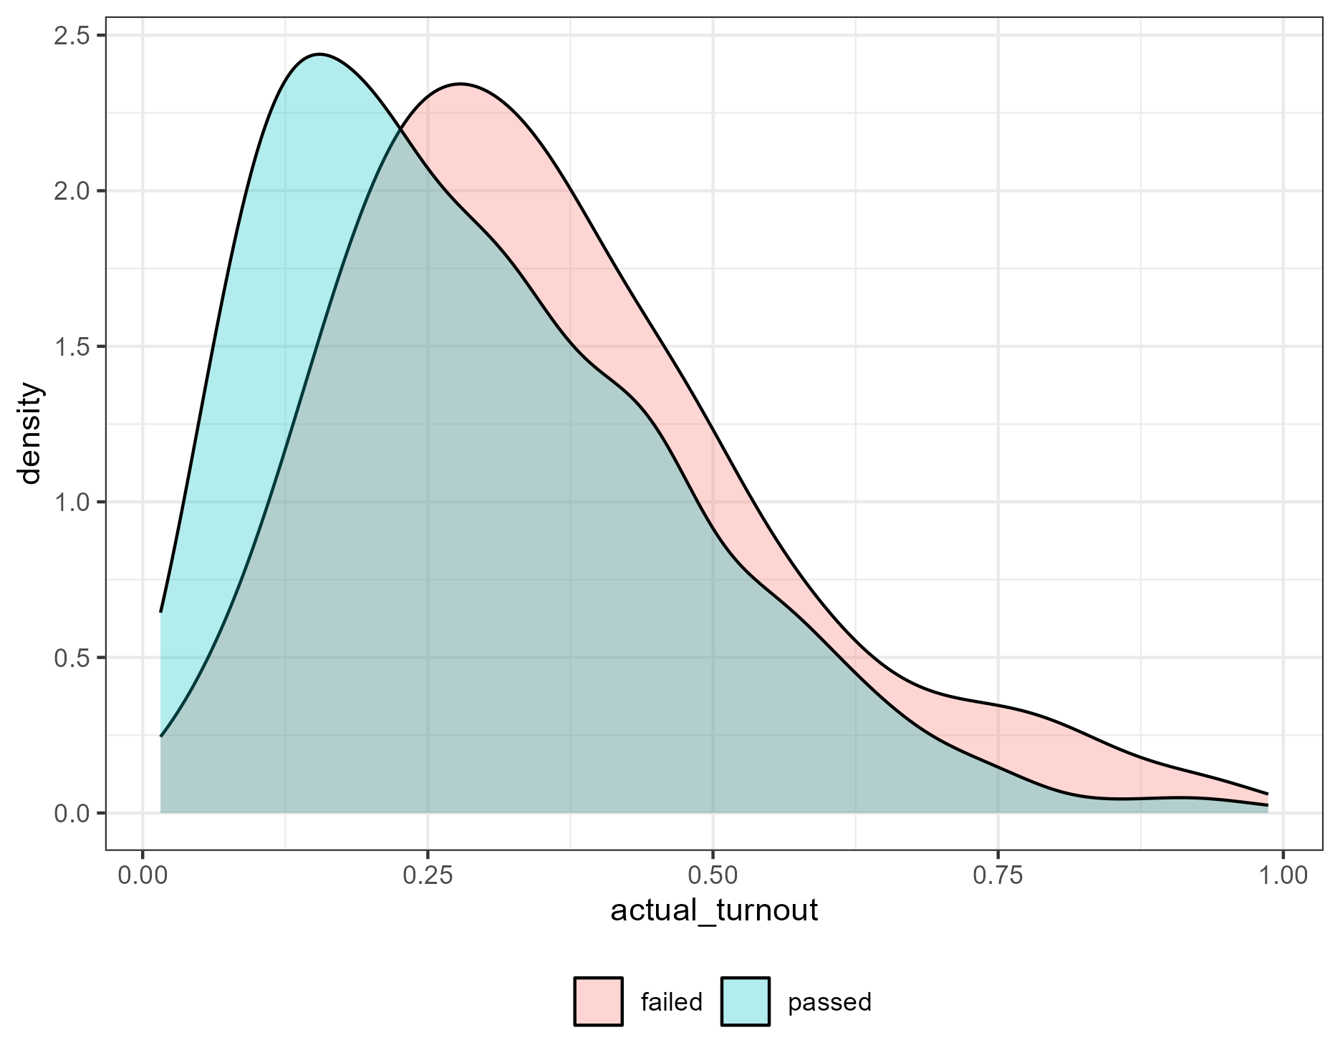
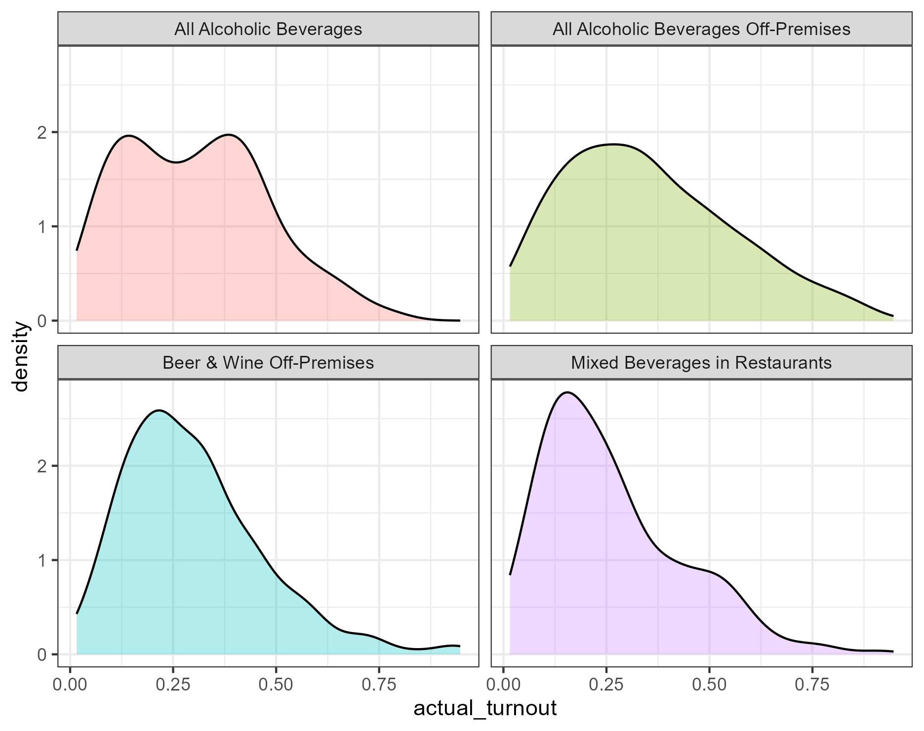
Turnout by result and type of issue

Slide 8
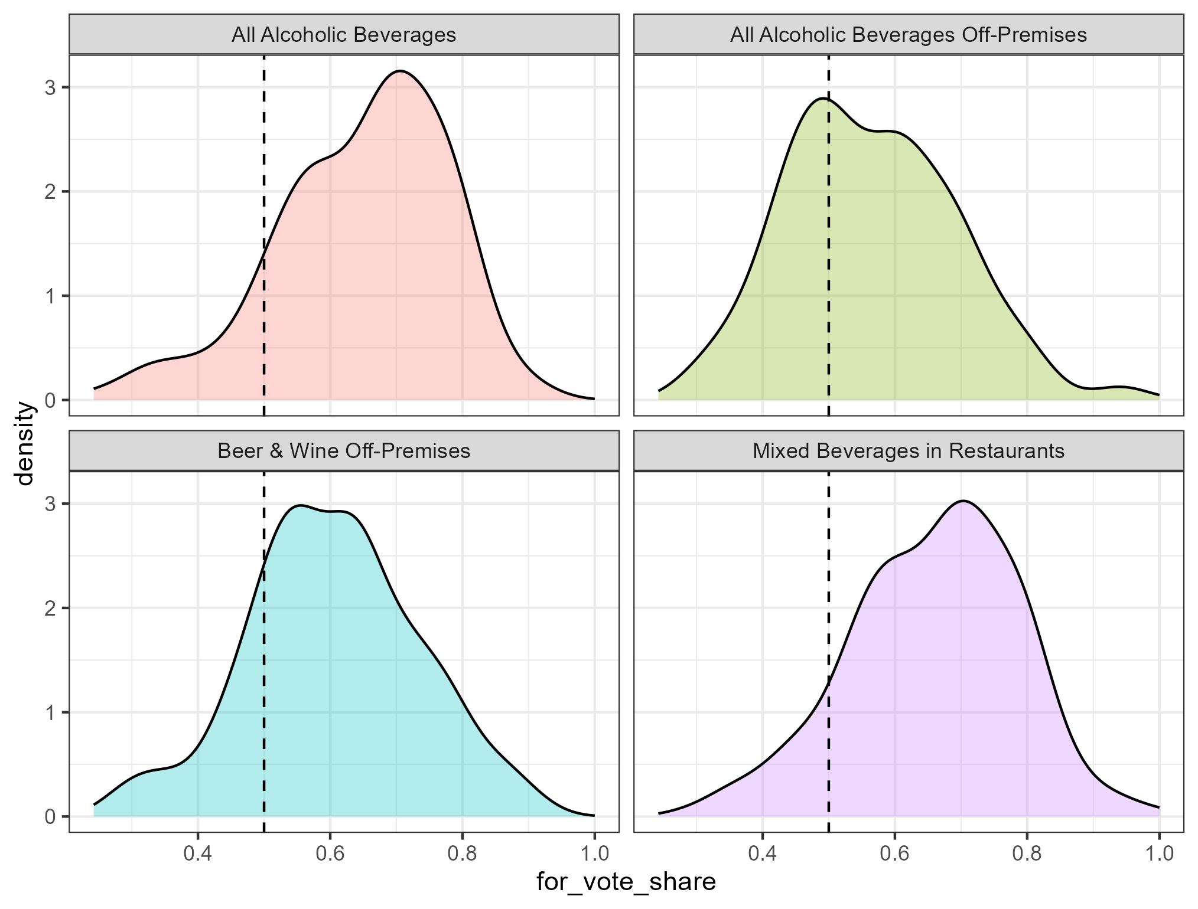
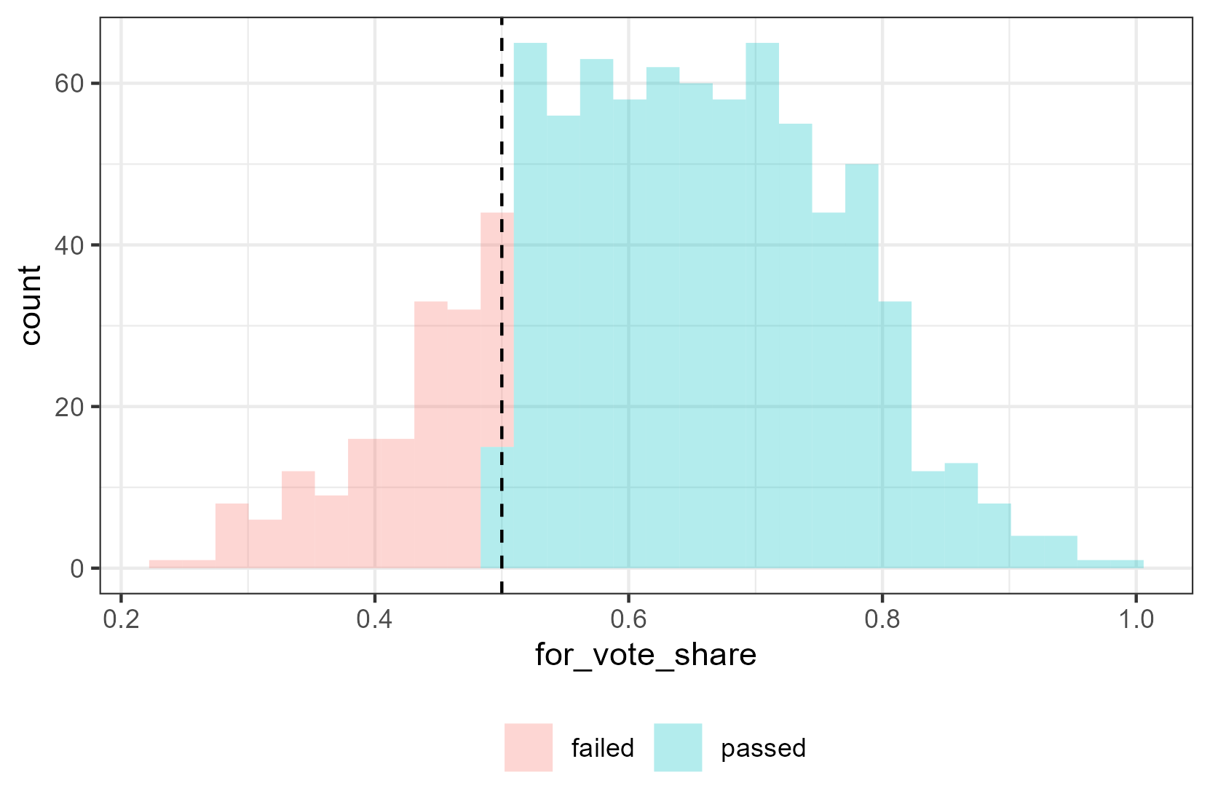
Distribution of for vote share
For vote implies voting in favor of alcohol sales (going from dry to wet)

Slide 9
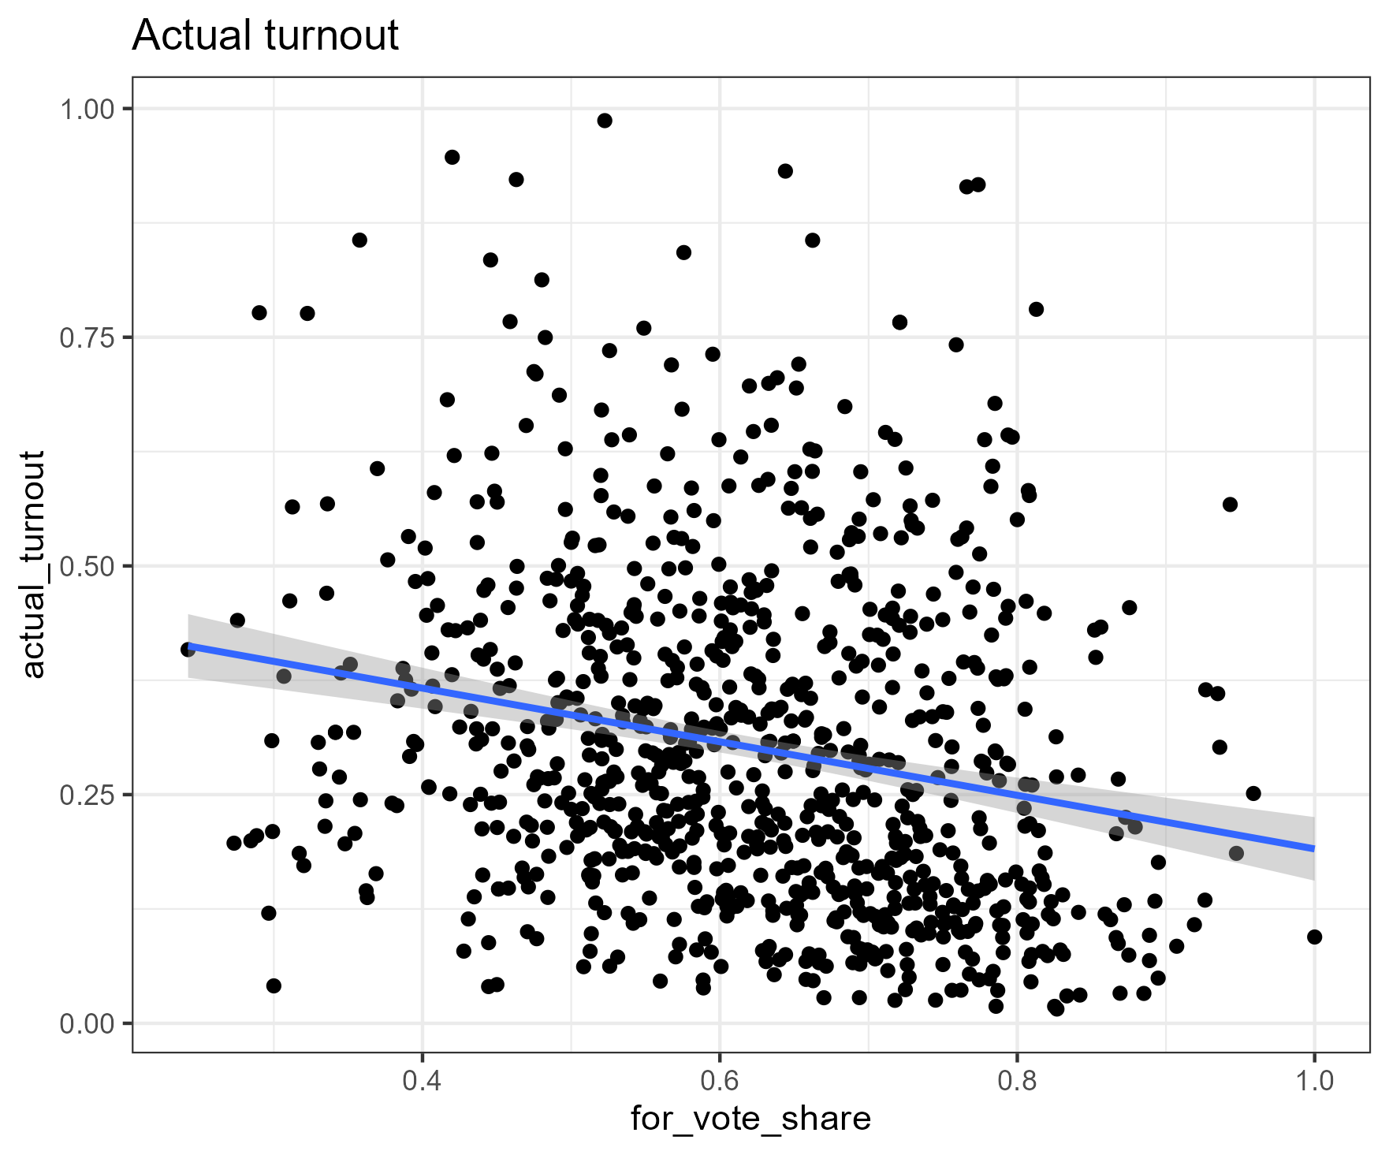
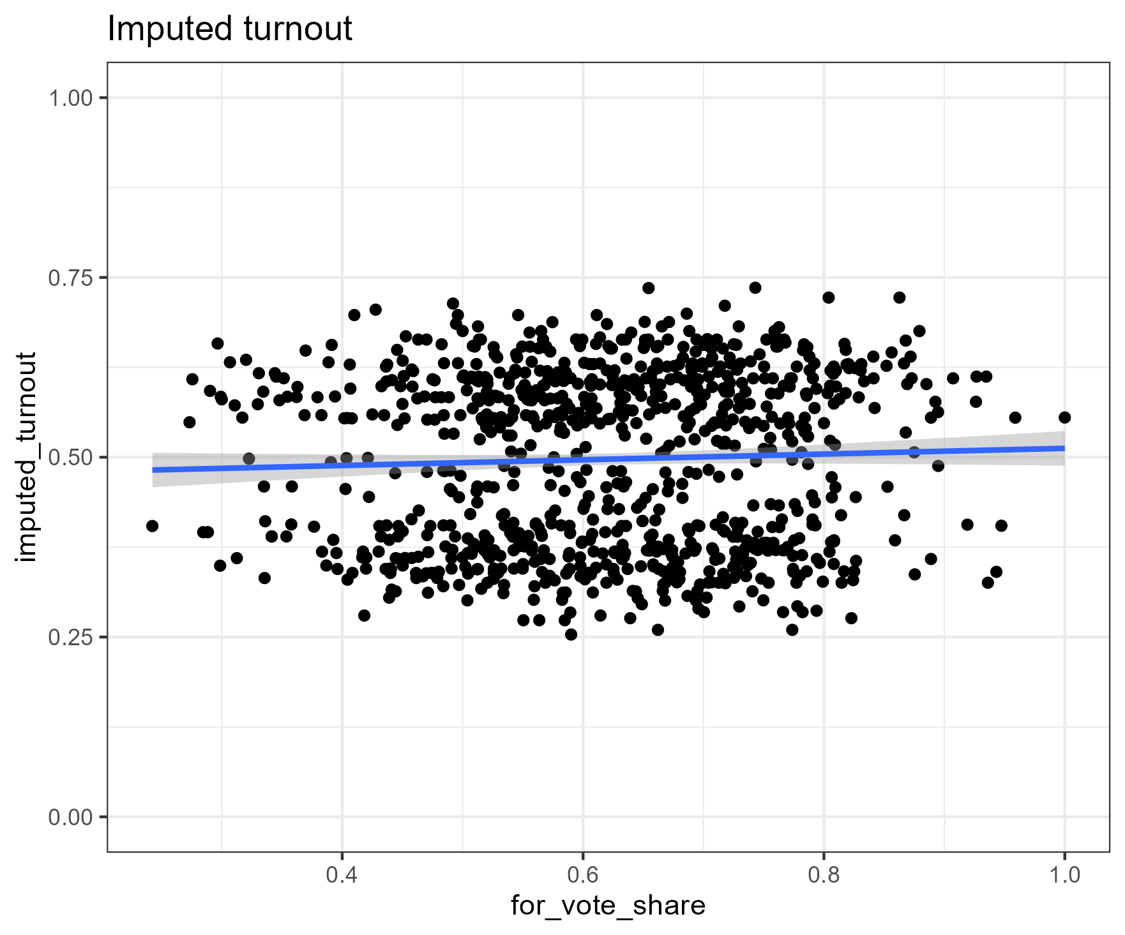
Turnout and for vote share

Slide 10
Religion and elections
The Religion data from US election census provides county level data on number of adherents of a particular religion
Data is only available for the years 1980, 1990, 2000, 2010
There are several issues with this data (for example undercounting black populations in the earlier years)
I aggregated elections to the county level, as well as to the years mentioned above. For example I aggregate all elections that happen in Harris County from 2005-2014 to the year 2010.

Slide 11
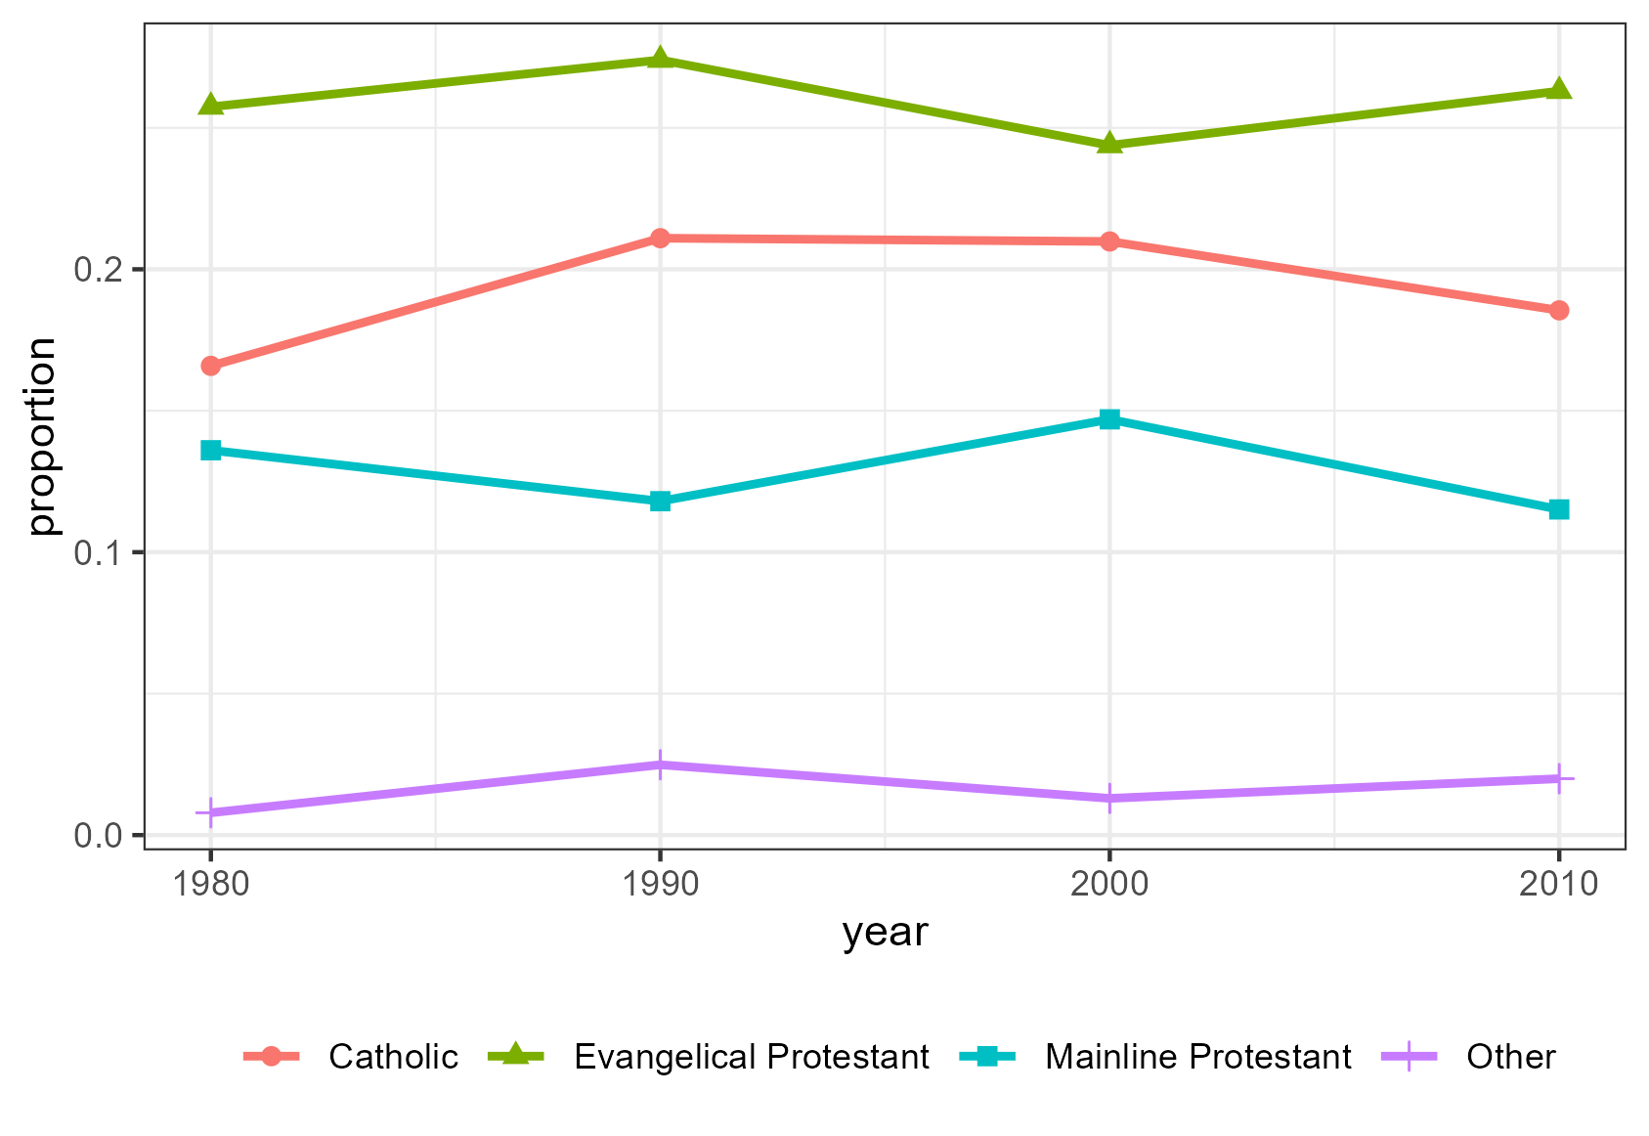
Religious composition of Texas Population
Largest group: Evangelical Protestants
The historical temperance movement had strong ties to Evangelical Protestant churches such as the Woman’s Christian Temperance Union

Slide 12
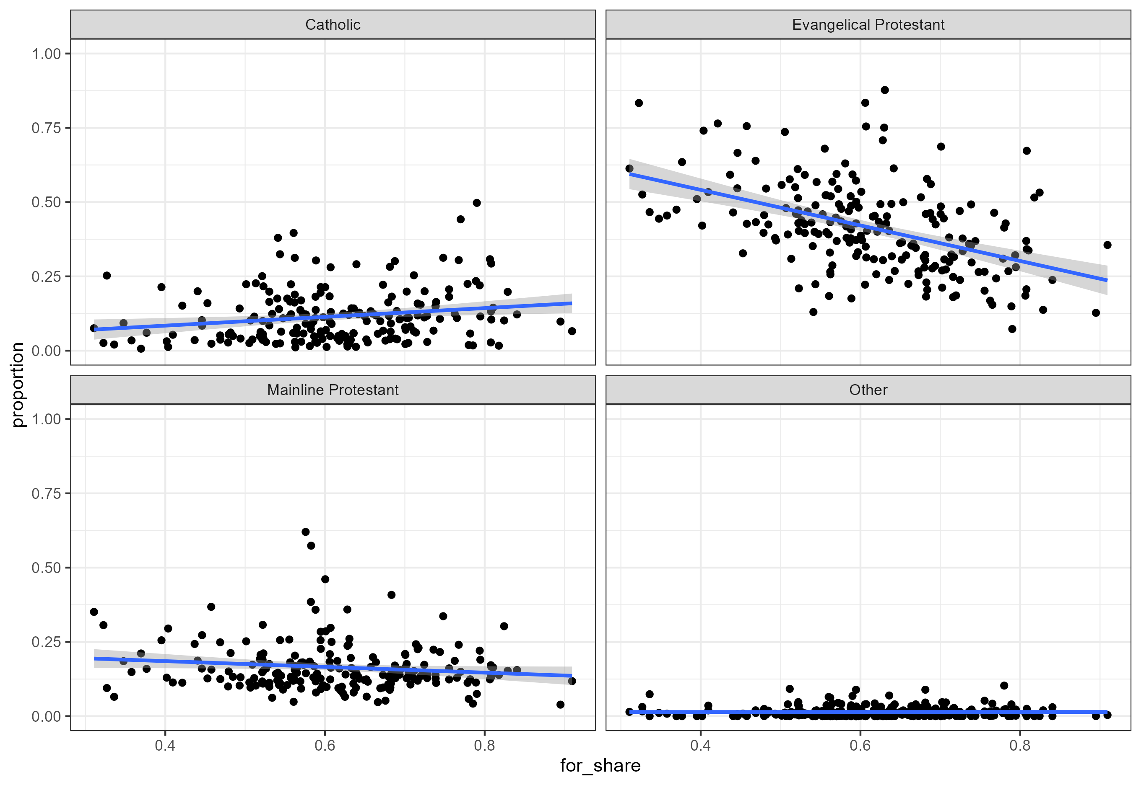
Religious composition and voting

Slide 13
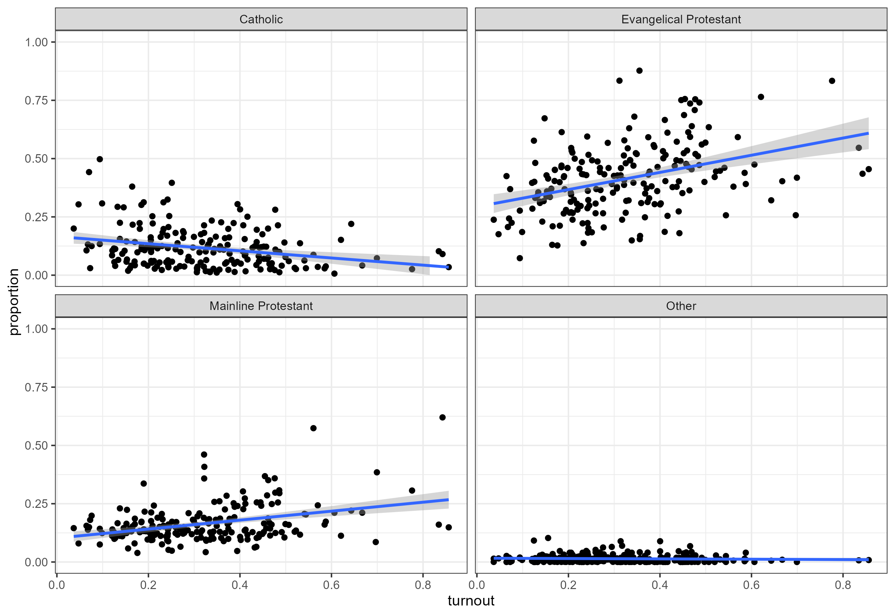
Religious composition and turnout in elections

